Slide 1
KMP
A substring matching algorithm

Slide 2
Problem
Given two string A and B find if B is a substring of A or not.
Given two string A and B find how many B are present in A as substring.
Example:
A = aaaaaaaaaaa
B = aaaa
Solution = 8
Input constraint : |A|<10⁵ and |B|<10⁵
0 | 1 | 2 | 3 | 4 | 5 | 6 | 7 | 8 | 9 | 10
a | a | a | a | a | a | a | a | a | a | a

Slide 3
Idea of KMP
We will make prefix array for the substring and try a linear search to find number of substring hidden in the string.
What do a prefix array do?
At I’th position if we count 0 to I a string then for this string what is the longest prefix which is also suffix for the string.
For example:
0 | 1 | 2 | 3 | 4 | 5 | 6 | 7
a | b | c | a | b | c | a | b
0 | 0 | 0 | 1 | 2 | 3 | ? | ?

Slide 4
Matching a string using prefix array
0 | 1 | 2 | 3 | 4 | 5
a | b | a | b | a | $
0 | 0 | 1 | 2 | 3 | 0
0 | 1 | 2 | 3 | 4 | 5 | 6 | 7 | 8 | 9
a | b | c | a | b | a | b | a | b | a
0 | 1 | ------ | 0 | 1 | 2 | 3 | 4 | 3 | 4

Slide 5
Matching a string using prefix array
0 | 1 | 2 | 3 | 4 | 5
a | b | a | b | a | $
0 | 0 | 1 | 2 | 3 | 0
0 | 1 | 2 | 3 | 4 | 5 | 6 | 7 | 8 | 9
a | b | c | a | b | a | b | a | b | a
0 | 1 | ------ | 0 | 1 | 2 | 3 | 4 | 3 | 4

Slide 6
Build this prefix array
0 | 1 | 2 | 3 | 4 | 5 | 6 | 7
a | b | c | d | a | b | c | a
0 | 0 | 0 | 0 | 1 | 2 | 3 | 1
0 | 1 | 2 | 3 | 4 | 5 | 6 | 7 | 8
a | a | b | a | a | b | a | a | a
0 | 1 | 0 | 1 | 2 | 3 | 4 | 5 | 2

Slide 7
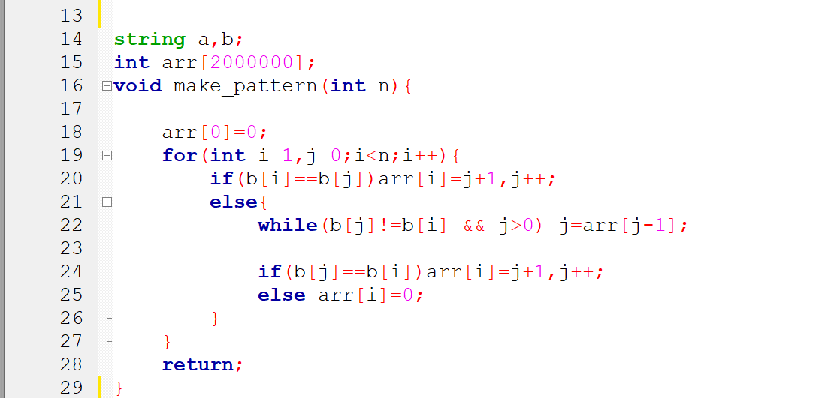
Let’s Code IT :::::::::::::::::::::::::::::::::::::::

Slide 8
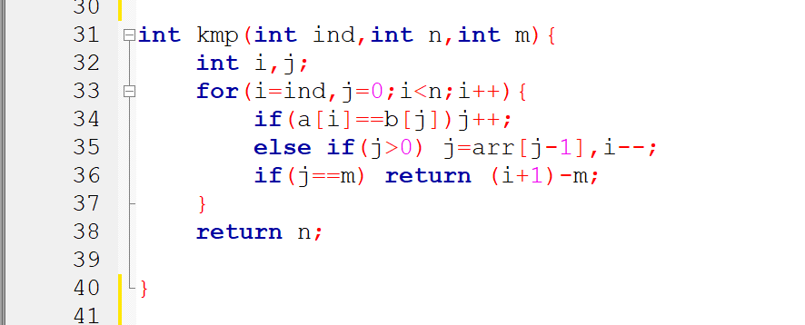
Matching ::::::::::::::::::::::::::::::::::::::::::

Slide 9
Problems to be solved
1) http://lightoj.com/volume_showproblem.php?problem=1255
2) https://www.spoj.com/problems/NHAY/
3) http://lightoj.com/volume_showproblem.php?problem=1258

